Slide 1
ALY 6070 Communication and Visualization for Data Analytics
Reduce Clutter by using
Gestalt principles of visual perception

Slide 2
Gestalt principles of visual perception
The Gestalt School of Psychology set out in the early 1900s to understand how individuals perceive order in the world around them.
What they came away with are the principles of visual perception still accepted today that define how people interact with and create order out of visual stimuli
Here we discuss: proximity, similarity, enclosure, closure, continuity, and connection
*source: https://www.safaribooksonline.com/library/view/storytelling-with-data/9781119002253/c03.xhtml

Slide 3
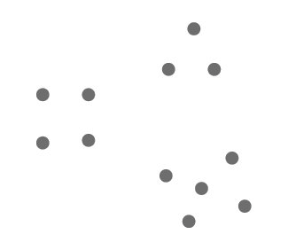
Proximity
We tend to think of objects that are physically close together as belonging to part of a group
*source: https://www.safaribooksonline.com/library/view/storytelling-with-data/9781119002253/c03.xhtml

Slide 4

Proximity
We can leverage this way that people see in table design
your eyes are drawn either down the columns in the first case or across the rows in the second case.
*source: https://www.safaribooksonline.com/library/view/storytelling-with-data/9781119002253/c03.xhtml

Slide 5
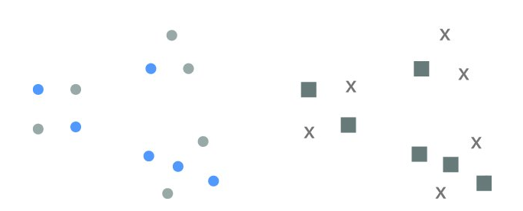
Similarity
Objects that are of similar color, shape, size, or orientation are perceived as related or belonging to part of a group
*source: https://www.safaribooksonline.com/library/view/storytelling-with-data/9781119002253/c03.xhtml

Slide 6
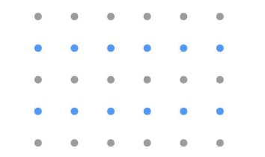
Similarity
This can be leveraged in tables to help draw our audience’s eyes in the direction we want them to focus.
Below, the similarity of color is a cue for our eyes to read across the rows (rather than down the columns).
This eliminates the need for additional elements such as borders to help direct our attention.
*source: https://www.safaribooksonline.com/library/view/storytelling-with-data/9781119002253/c03.xhtml

Slide 7
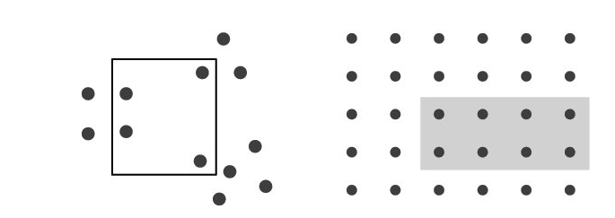
Enclosure
We think of objects that are physically enclosed together as belonging to part of a group.
*source: https://www.safaribooksonline.com/library/view/storytelling-with-data/9781119002253/c03.xhtml

Slide 8
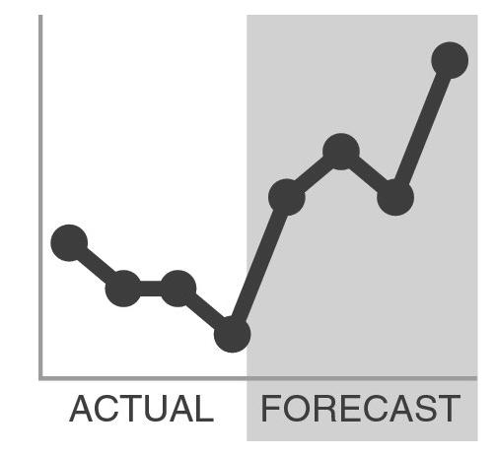
Enclosure
One way we can leverage the enclosure principle is to draw a visual distinction within our data
*source: https://www.safaribooksonline.com/library/view/storytelling-with-data/9781119002253/c03.xhtml

Slide 9

Closure
The closure concept says that people like things to be simple and to fit in the constructs that are already in our heads.
Because of this, people tend to perceive a set of individual elements as a single, recognizable shape when they can
When parts of a whole are missing, our eyes fill in the gap.
*source: https://www.safaribooksonline.com/library/view/storytelling-with-data/9781119002253/c03.xhtml

Slide 10
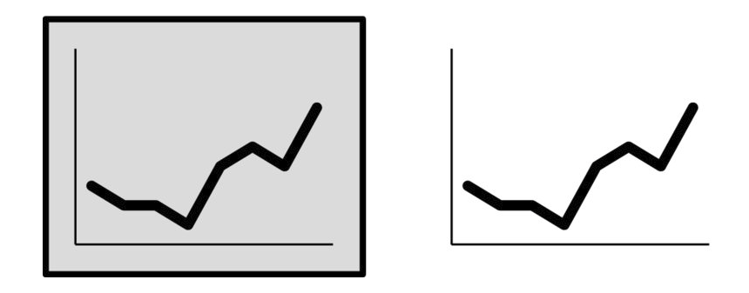
Closure
It is common for graphing applications (for example, Excel) to have default settings that include elements like chart borders and background shading.
The closure principle tells us that these are unnecessary—we can remove them and our graph still appears as a cohesive entity.
*source: https://www.safaribooksonline.com/library/view/storytelling-with-data/9781119002253/c03.xhtml

Slide 11
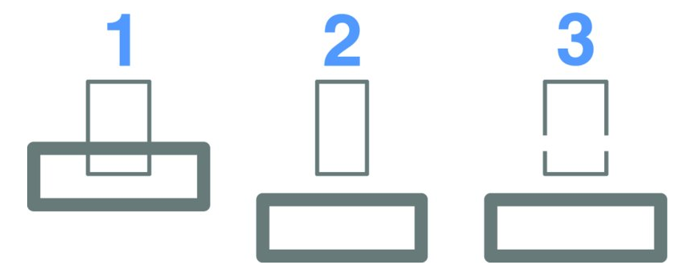
Continuity
The principle of continuity is similar to closure
when looking at objects, our eyes seek the smoothest path and naturally create continuity in what we see even where it may not explicitly exist.
*source: https://www.safaribooksonline.com/library/view/storytelling-with-data/9781119002253/c03.xhtml

Slide 12
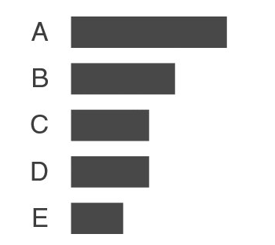
Continuity
Removed the vertical y-axis line from the graph below
Your eyes actually still see that the bars are lined up at the same point because of the consistent white space
*source: https://www.safaribooksonline.com/library/view/storytelling-with-data/9781119002253/c03.xhtml

Slide 13
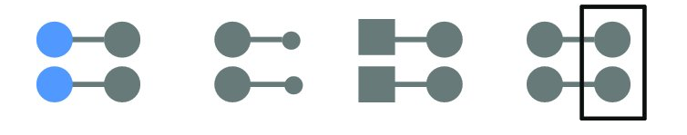
Connection
We tend to think of objects that are physically connected as part of a group.
The connective property typically has a stronger associative value than similar color, size, or shape.
Below, your eyes probably pair the shapes connected by lines (rather than similar color, size, or shape)
The connective property isn’t typically stronger than enclosure
*source: https://www.safaribooksonline.com/library/view/storytelling-with-data/9781119002253/c03.xhtml

Slide 14
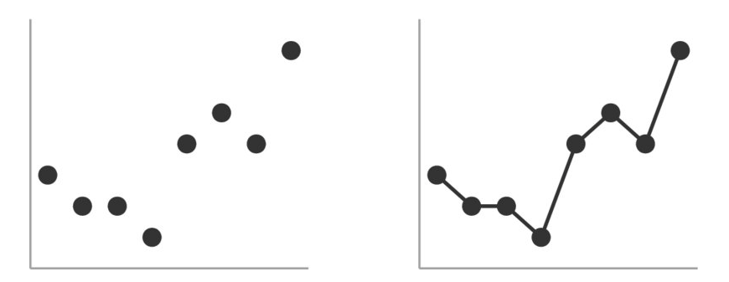
Connection
One way that we frequently leverage the connection principle is in line graphs, to help our eyes see order in the data
*source: https://www.safaribooksonline.com/library/view/storytelling-with-data/9781119002253/c03.xhtml

Slide 15
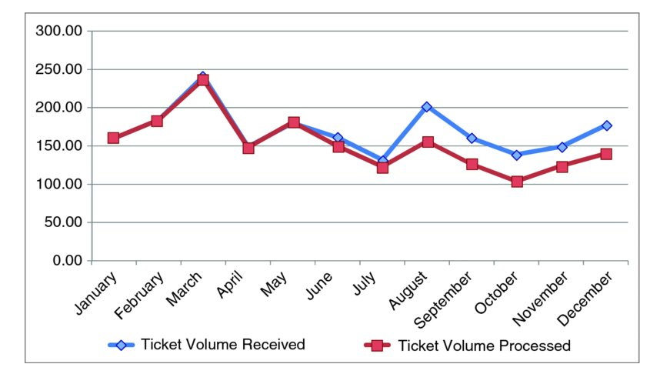
Decluttering Step by Step
*source: https://www.safaribooksonline.com/library/view/storytelling-with-data/9781119002253/c03.xhtml

Slide 16
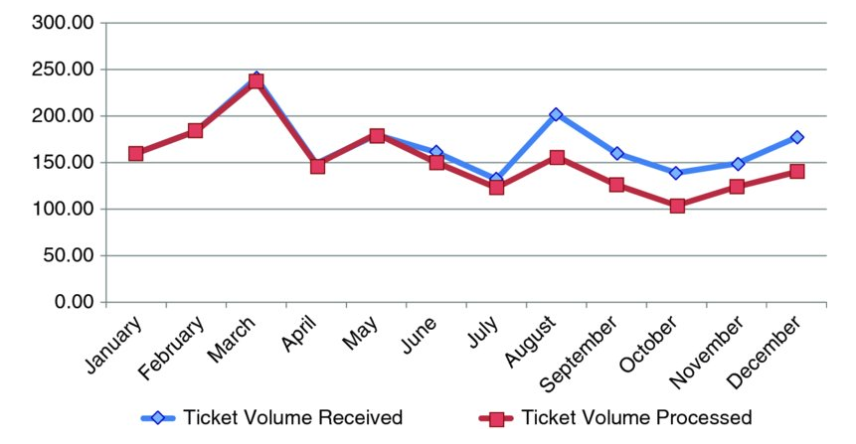
1) Remove chart borders Gestalt Principle: Closure
*source: https://www.safaribooksonline.com/library/view/storytelling-with-data/9781119002253/c03.xhtml

Slide 17
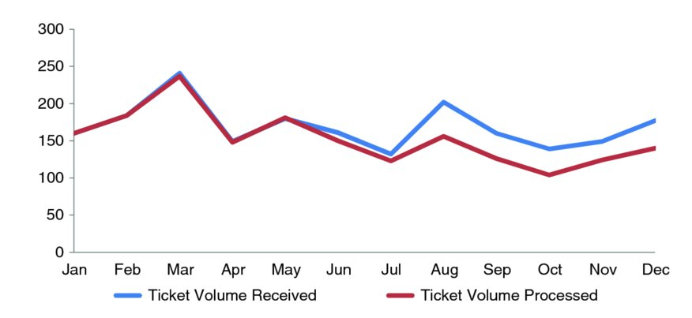
2) Eliminate clutter: remove grid lines, data labels, axis 000’s
*source: https://www.safaribooksonline.com/library/view/storytelling-with-data/9781119002253/c03.xhtml

Slide 18
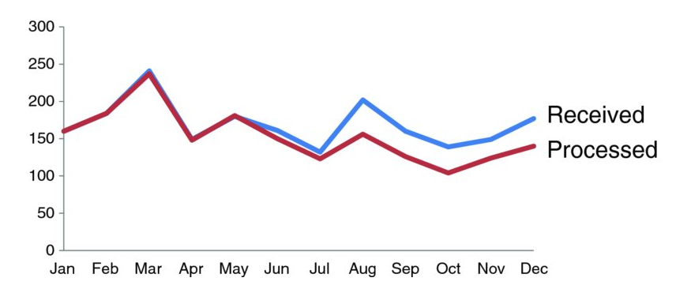
3) Label data directly Gestalt Principle: Proximity
*source: https://www.safaribooksonline.com/library/view/storytelling-with-data/9781119002253/c03.xhtml

Slide 19
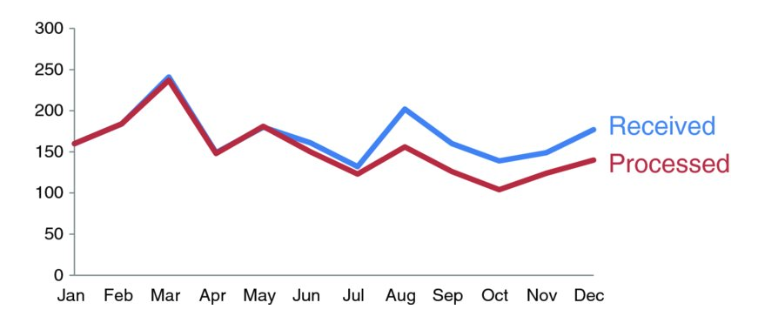
4) Consistent color Gestalt Principle: Similarity
*source: https://www.safaribooksonline.com/library/view/storytelling-with-data/9781119002253/c03.xhtml

Slide 20
Closing
Any time you put information in front of your audience, you are creating cognitive load
Visual clutter creates excessive cognitive load
The Gestalt Principles of Visual Perception can help you understand how your audience sees and allow you to identify and remove unnecessary visual elements
Leverage alignment of elements and maintain white space to help make the interpretation of your visuals a more comfortable experience for your audience
Use contrast strategically
*source: https://www.safaribooksonline.com/library/view/storytelling-with-data/9781119002253/c03.xhtml

